Slide 1
IN PARTNERSHIP WITH EVENT SPONSORS

Slide 2
ROAD SAFE NI
Northern Ireland
Primary School
Road Safety Quiz Final
2020

Slide 4
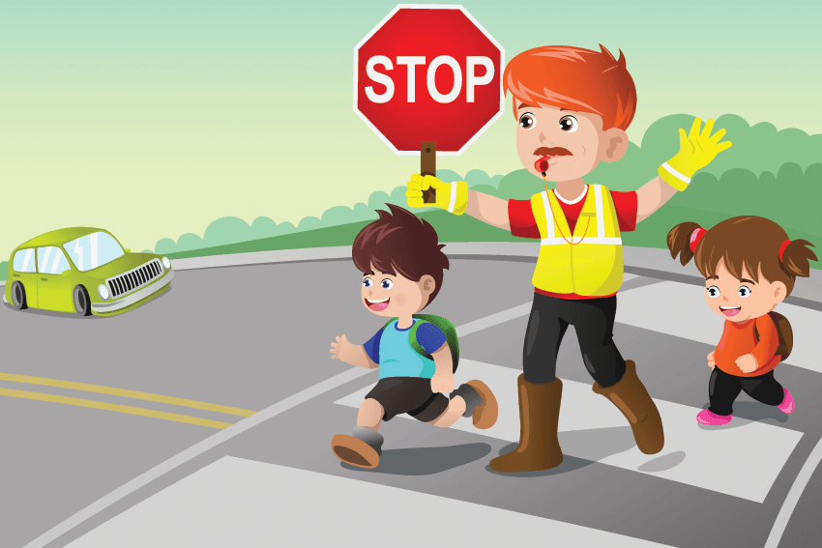
ROUND 1
ROAD SAFETY

Slide 5
Which pedestrian crossings have the same name as an animal?
Which is the only road sign that is the same shape in virtually every country in the world ?
What is the overall stopping distance for a car traveling at 70 mph?
What colour are the zig zag lines on approach to a pedestrian crossing?
Which animal appears on UK traffic signs giving tourist directions to a zoo?
What colour is the background on signs giving directions to a hospital with an Accident & Emergency Department (A&E)?
Reflective materials can be seen in the dark by drivers up to how many times as far away as non reflective materials?
When there is an island in the middle of a zebra crossing, you should do what?

Slide 6
ROUND 2
GENERAL
KNOWLEDGE

Slide 7
What type of creature is a dingo?
In which country is the Taj Mahal?
What are the names of Harry Potter’s parents?
Name the five oceans of the world?
What is the official language of Brazil?
Which Royal celebrated his 60th Birthday on 19th February this year? ?
How many sides does a heptagon have ?
How many strings are there on a violin?

Slide 8
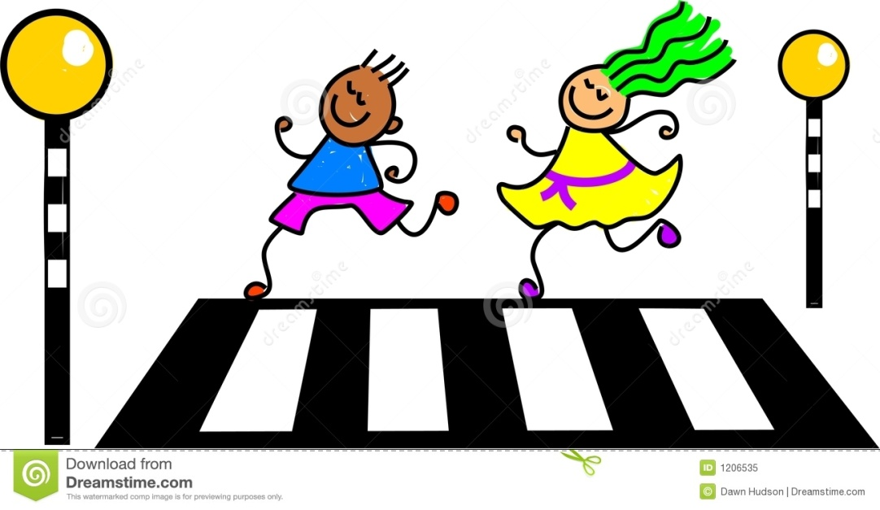
ROUND 3
ROAD SAFETY

Slide 9
If you have to cross the road between parked vehicles, you should use the outside edge of the vehicle as if it were what?
When walking on a road without a footpath, when may it be safer to cross to the left side of the road ?
At traffic lights, what does an amber light on its own mean ?
What colour is the background on signs giving directions to a hospital without an Accident & Emergency Department (A&E)?
By how much does the braking distance increase in wet weather ?
According to the Highway Code for Northern Ireland, which road users are the most vulnerable?
What type of driving licence is granted before passing your driving test ?
When are pedestrians permitted to walk on a motorway ?

Slide 10
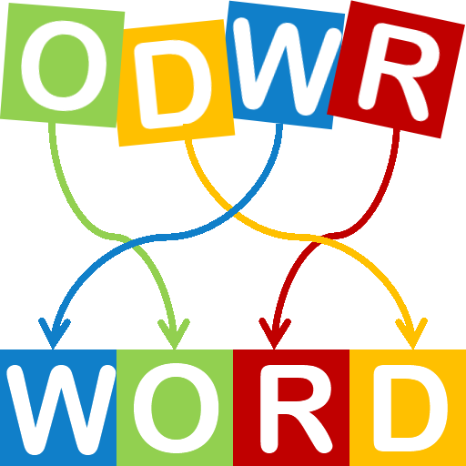
ROUND 4
GAANARSM
(ANAGRAMS)

Slide 11
DOHA HURDLERS 2 WORDS
2. APRON KING 2 WORDS
3. BEILUL DENSE WOOLLY 3 WORDS
4. DESI LIMPET 2 WORDS
5. AD MEMES MIXUP 2 WORDS
6. AIRDROP SLYPE 2 WORDS
7. AMOTION BURUNDI 2 WORDS
8. ACENTRIC OFF 2 WORDS

Slide 12
ROUND 5
ROAD SIGNS

Slide 13
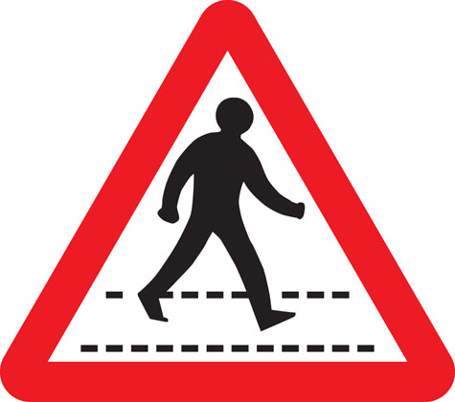
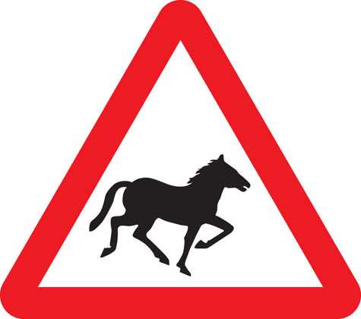
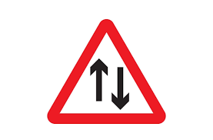
Identify the road sign
1
2
4
3

Slide 14
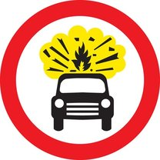
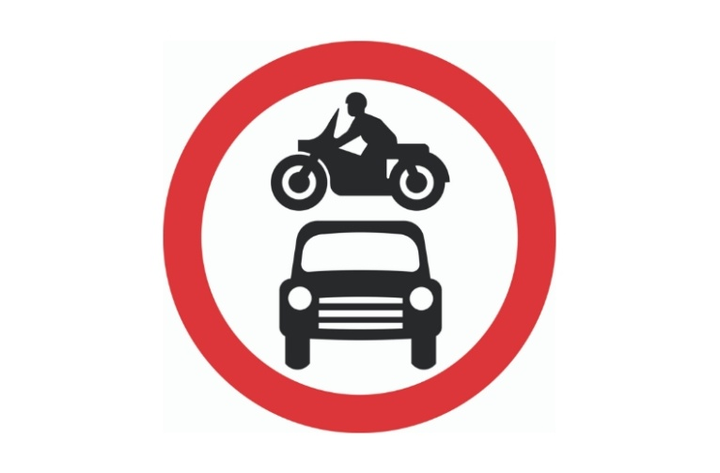
Identify the road sign
5
6
8
7

Slide 15
ROUND 6
LOGOS AND
SLOGANS

Slide 16
1
2
3
4

Slide 17
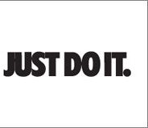
6
5
8
7

Slide 18
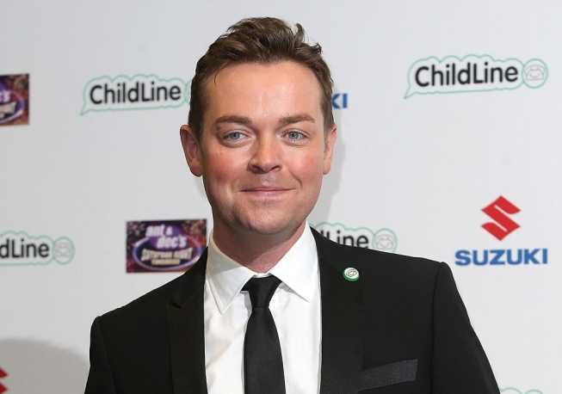
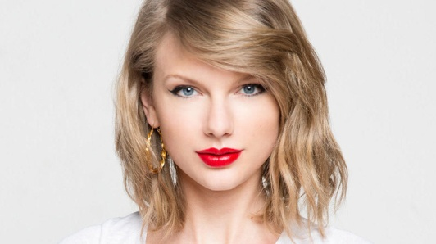
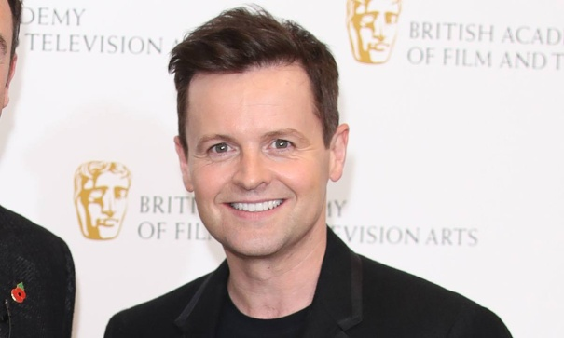
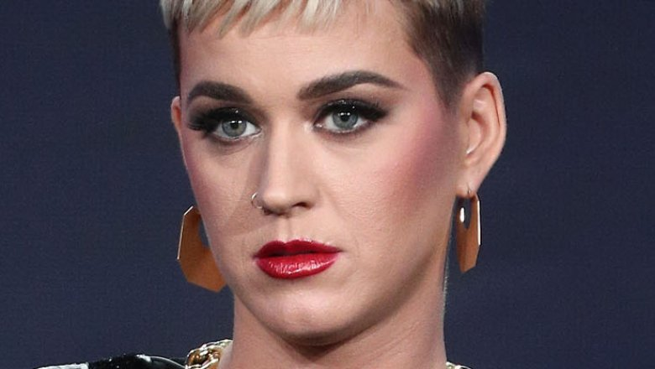
ROUND 7
WHO IS THAT
STAR

Slide 19
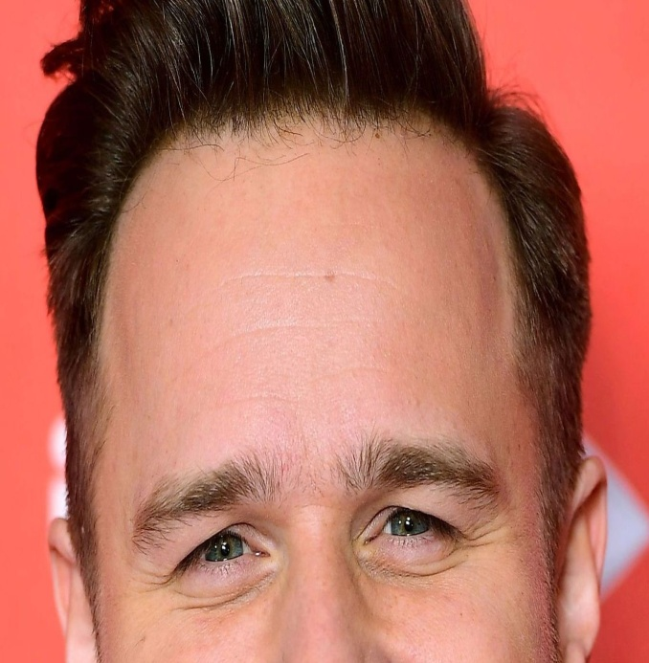
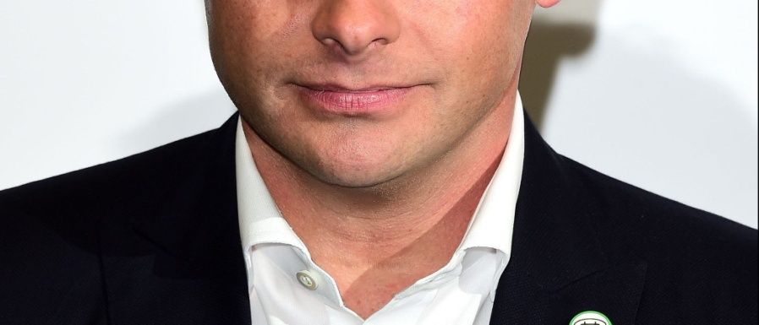
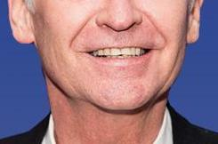
3
1
2
4

Slide 20
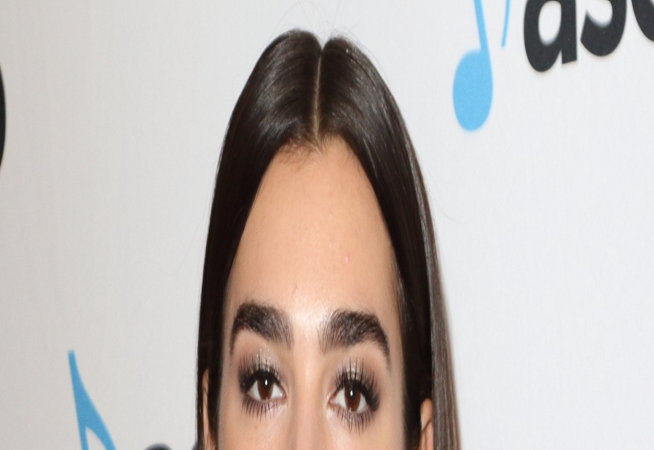
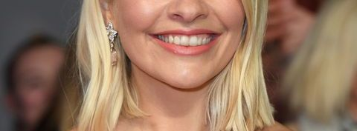
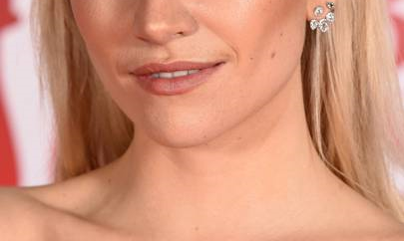
5
5
8
6

Slide 21
ROUND 8
ROAD SAFETY

Slide 22
At night the rear lookout on an organised walk should carry what?
After getting off a bus, what should you do before crossing the road ?
On one-way Streets, what may operate in the opposite direction to other traffic?
Which type of traffic light controlled crossings do not have a flashing green man?
When is the only time that it is legal to cycle on a pavement?
When can you carry a passenger on a bicycle?
You should never cross the road behind a vehicle showing what ?
When cycling at night what type of clothing should you wear ?

Slide 23
ROUND 1
ROAD SAFETY
ANSWERS

Slide 24
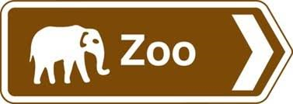
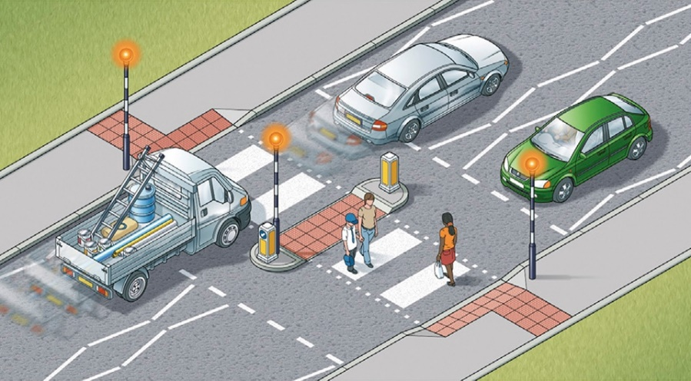
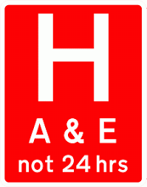
PELICAN, PUFFIN, TOUCAN AND ZEBRA
STOP SIGN.
96 METERS or 315 FEET
WHITE
5. ELEPHANT
6. RED
7. Up to 3 TIMES
8. WAIT ON THE ISLAND AND TREAT THE SECOND HALF OF THE ROAD AS A SEPARATE CROSSING.

Slide 25
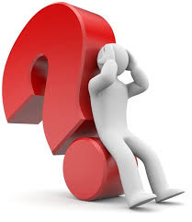
ROUND 2
GENERAL
KNOWLEDGE
ANSWERS

Slide 26
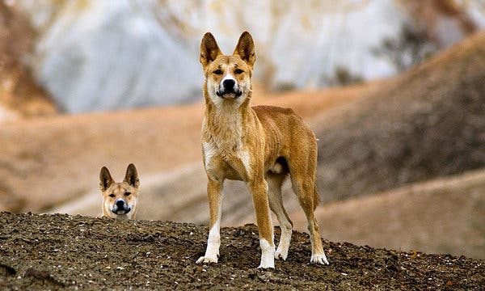
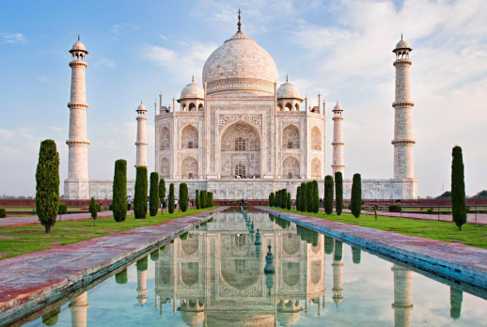
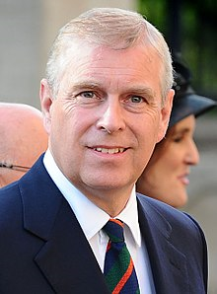
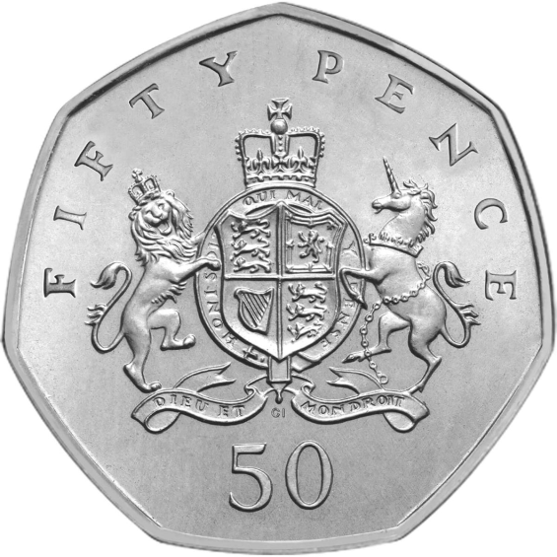
WILD DOG found in Australia
INDIA
JAMES AND LILY
ARCTIC, ATLANTIC, INDIAN, PACIFIC AND SOUTHERN
PORTUGUESE
Prince Andrew
SEVEN SIDES
FOUR

Slide 27
ROUND 3
ROAD SAFETY
ANSWERS

Slide 28
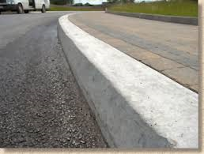
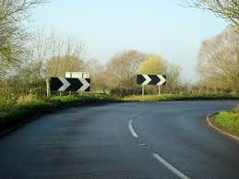
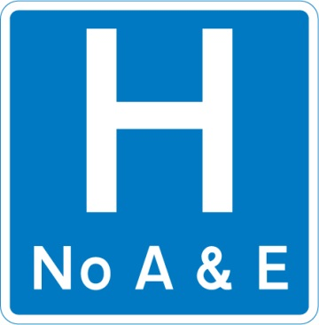
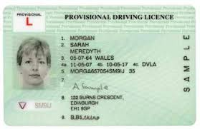
THE KERB
BEFORE A SHARP RIGHT HAND BEND
STOP.
BLUE.
IT DOUBLES
PEDESTRIANS, CYCLISTS, MOTORCYCLISTS AND HORSE RIDERS
PROVISIONAL
ONLY IN AN EMERGENCY TO WALK TO AN EMERGENCY TELEPHONE.

Slide 29
ROUND 4
ANAGRAMS
ANSWERS

Slide 30
DOHA HURDLERS
HARD SHOULDER
APRON KING
NO PARKING
BEILUL DENSE WOOLLY
DOUBLE YELLOW LINES
DESI LIMPET
SPEED LIMIT
AD MEMES MIXUP
MAXIMUM SPEED
AIRDROP PYLES
SLIPPERY ROAD
AMOTION BURUNDI
MINI ROUNDABOUT
ACENTRIC OFF
TRAFFIC CONE

Slide 31
ROUND 5
ROAD SIGNS
ANSWERS

Slide 32
Identify the road sign
1
2
Zebra crossing
Wild horses or ponies
4
3
Two-way traffic straight ahead
Double bend first to left

Slide 33
Identify the road sign
5
6
Manually operated
temporary STOP/GO sign
No vehicles
carrying explosives
8
7
No Waiting
No motor vehicles

Slide 34
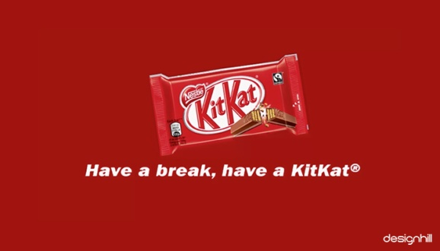
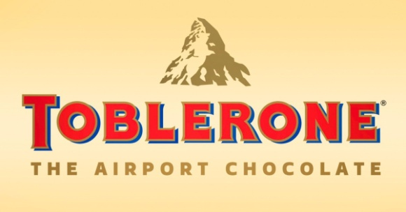
ROUND 6
LOGOS AND SLOGANS
ANSWERS

Slide 35
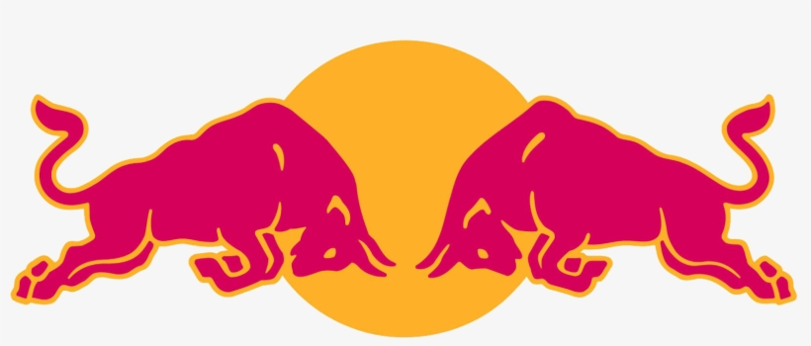
1
2
4
3

Slide 36
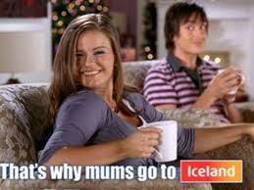
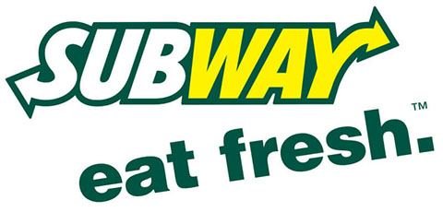
6
5
8
7

Slide 37
ROUND 7
WHO IS THAT
STAR
ANSWERS

Slide 38
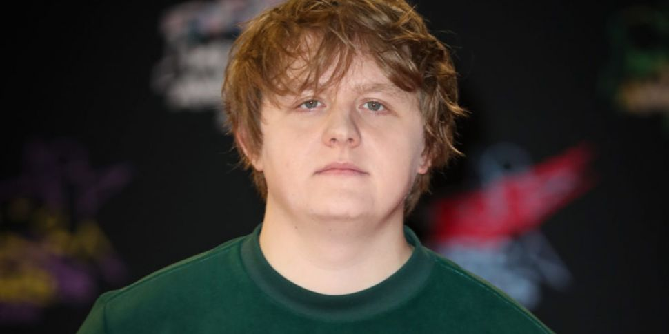
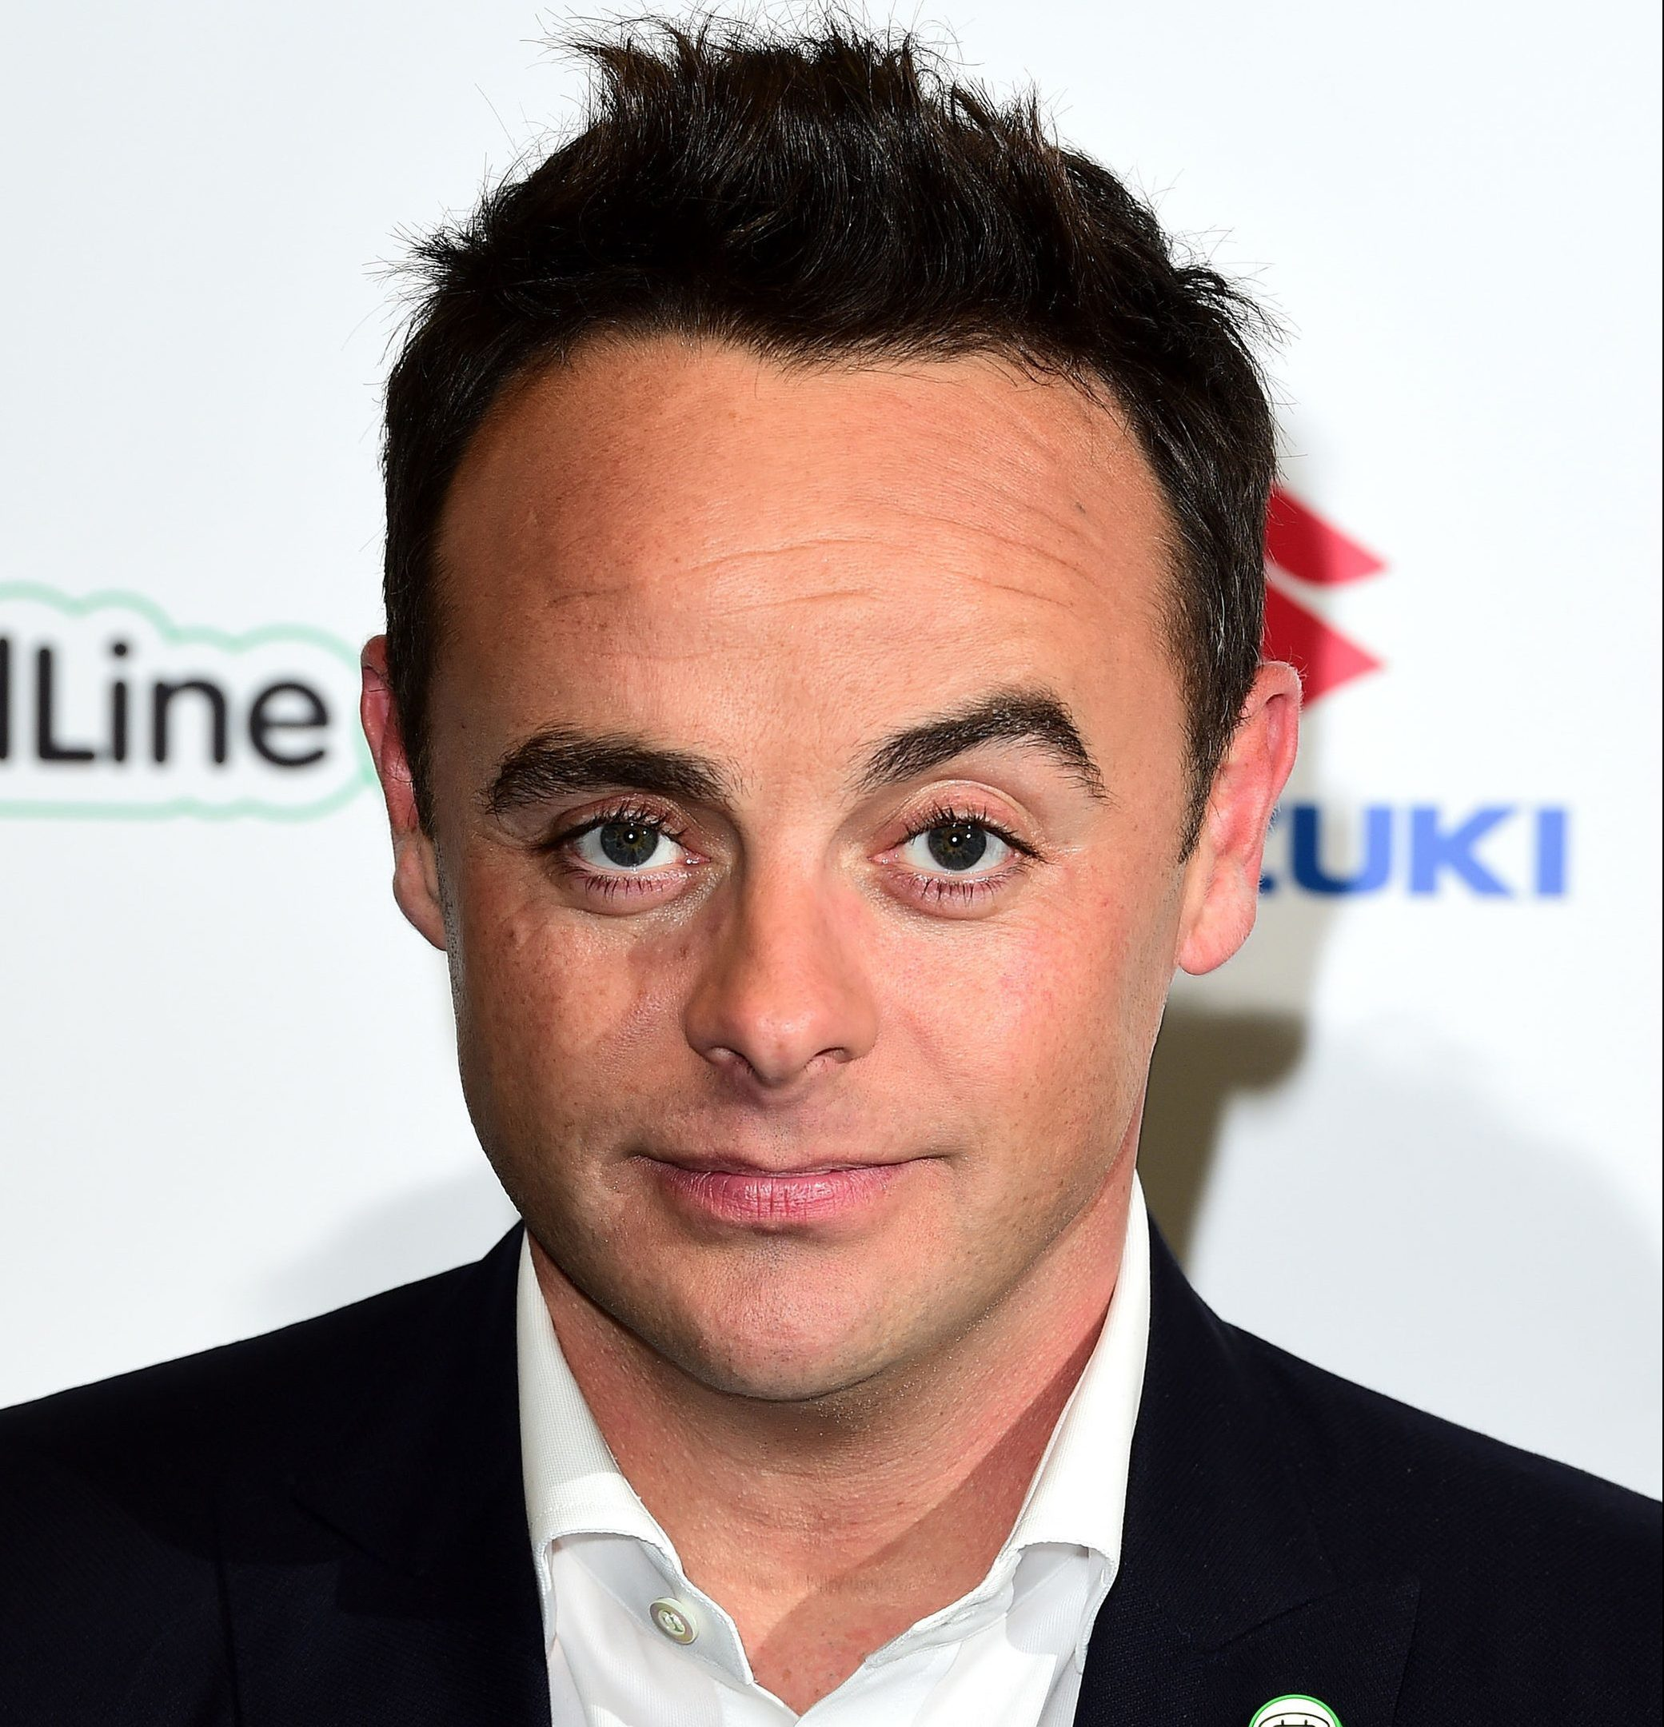
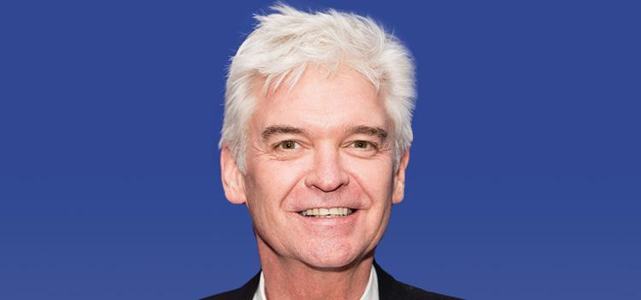

Slide 39
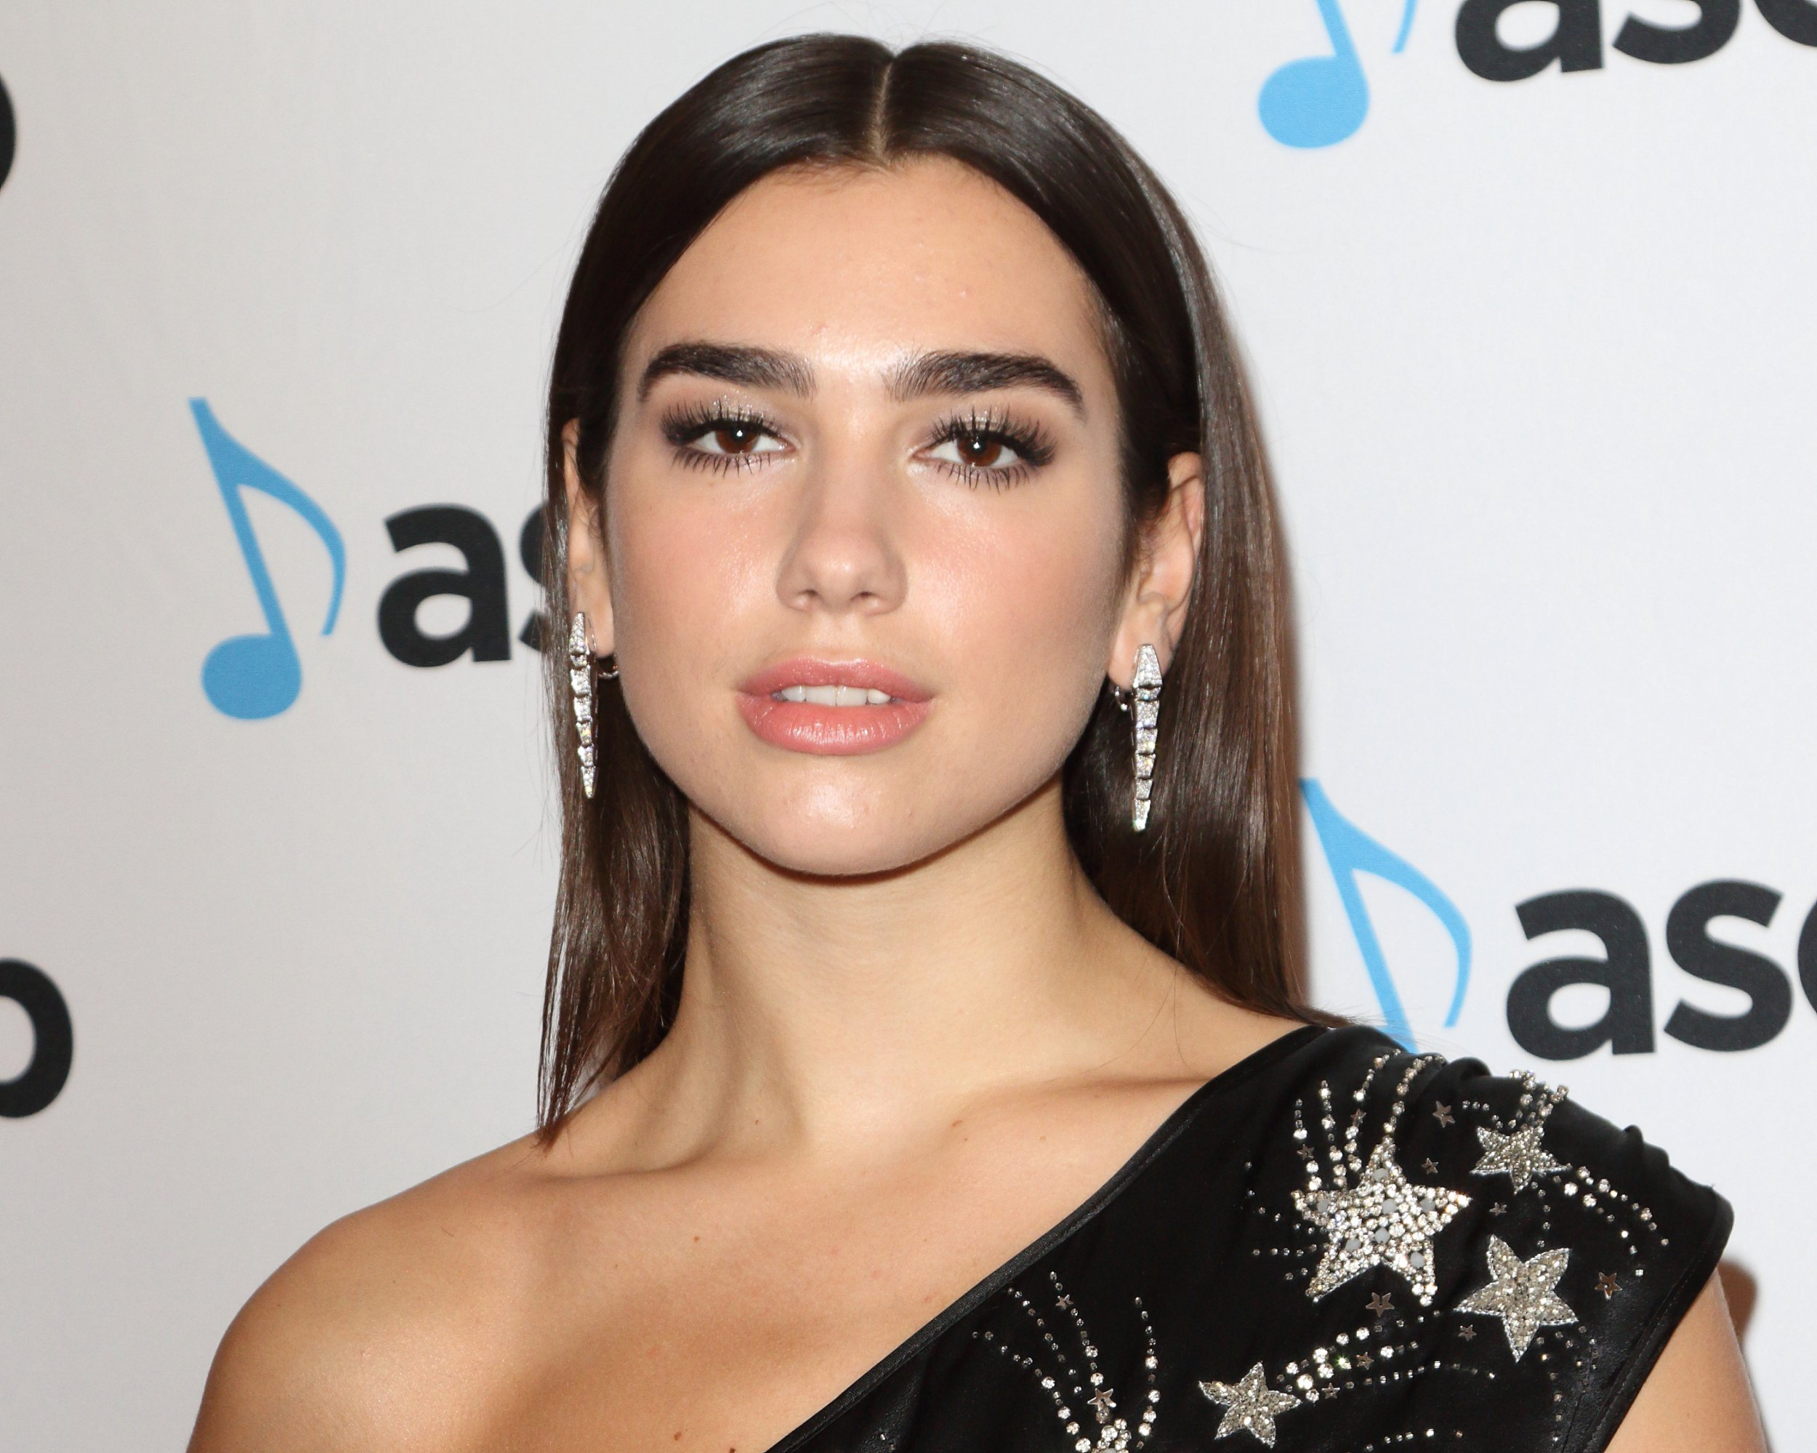

Slide 40
ROUND 8
ROAD SAFETY
ANSWERS

Slide 41
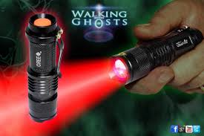
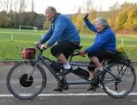
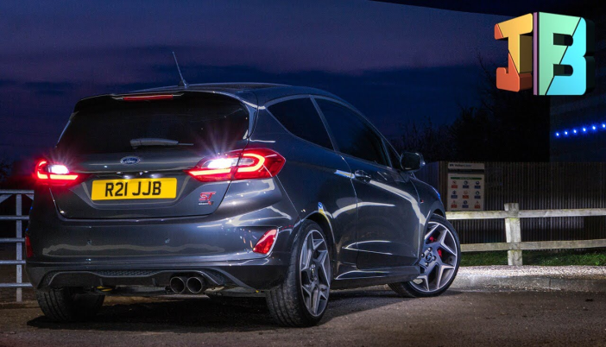
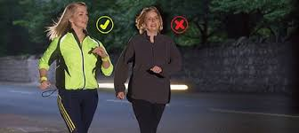
A RED LIGHT
2. WAIT TILL THE BUS HAS MOVED OFF.
3. BUS AND CYCLE LANES
4. PUFFIN AND TOUCAN CROSSINGS.
5. WHEN THERE IS A DESIGNATED MARKED CYCLE PATH ON IT
6. ONLY ON A BICYCLE BUILT FOR TWO
7. WHITE REVERSING LIGHTS
8. REFLECTIVE

Slide 43
Connect to FREE WIFI log on to survey monkey at
https://www.surveymonkey.co.uk/r/9RBMF9K
Paper copies of the evaluation are also available at the back of the room.
Thank you

Slide 44
www.facebook.com/roadsafeni
FOR PICTURES OF THIS EVENT
THANK YOU - SAFE HOME

